Slide 1
Guided development of the Evidence Code Ontology with OBI
Marcus C. Chibucos, Ph.D.
Institute for Genome Sciences, University of Maryland, Baltimore, MD

Slide 2
Take-home messages from this talk…
Fundamentals: where to begin if you are new to OBI… just like me!
Visualizing the ontology
How to get involved with the OBI group
How to prepare your ontology before working with OBI
Ontology cleanup
Knowing users
What is your ontology trying to represent?
How can OBI guide development of your ontology?
Can the way information is represented in OBI help clarify thinking?
Surveying your ontology and comparing it to OBI
Examples of an initial mapping of an ontology term to OBI
…and the caveats – none of this is an officially sanctioned view— it is my process!
This talk could be titled “How to start a conversation with OBI…”

Slide 3
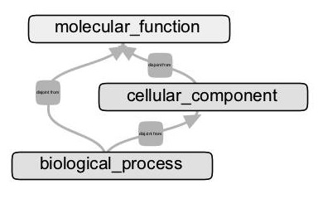
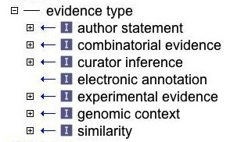
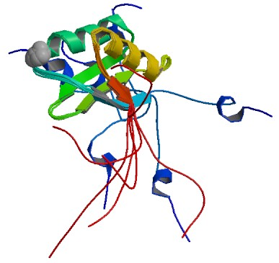
The subject of this talk
The Evidence Code Ontology (ECO)
Who uses ECO and to what end?
What do we mean by evidence?
How is OBI helping resolve issues of consistency within ECO?
Can ECO contribute to OBI development?
Arabidopsis thaliana ATPase
HMA4 zinc binding domain
GO:0006829 : zinc ion transport (BP)
GO:0005886 : plasma membrane (CC)
GO:0005515 : protein binding (MF)

Slide 4
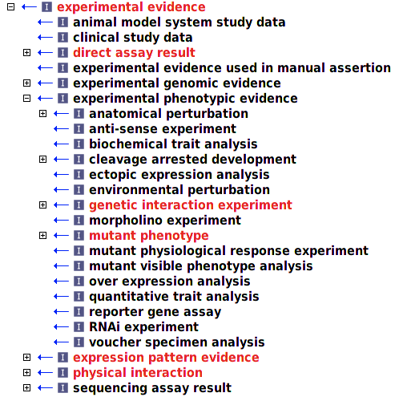
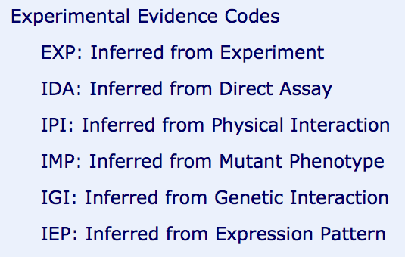
GO three-letter codes ECO subset
EXP
IDA
IGI
IMP
IEP
IPI
(Some of the over 250 ECO terms)
(Approximately 20 GO codes exist)

Slide 5
Who uses ECO?
GO model organism databases (TAIR, MGI, dictyBase, FlyBase, SGD, ZFIN…)
Ascidian Network for In Situ Expression and Embryological Data
Ontology of Microbial Phenotypes
Phylogenetic Annotation and INference Tool (PAINT) - GO Reference Genome Annotation Project
PhenoScape
PomBase – phenotype annotations
UniProt - granular terms & term for imported information
Hymenoptera Anatomy Ontology
Probably others unknown to us…

Slide 6
Fundamentals
Where to begin if you are new to OBI

Slide 7

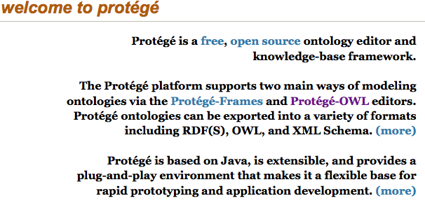
Visualizing the ontology
Protégé tool
If you only know OBO-Edit, learn how to use Protégé
Learn the structure of OBI and how it is put together
http://purl.obolibrary.org/obo/obi.owl

Slide 8

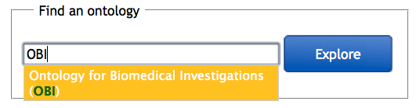
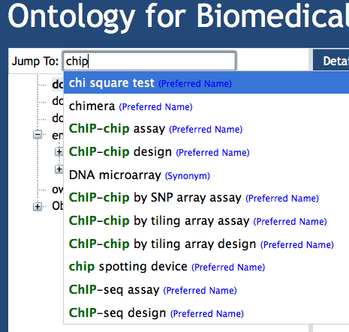
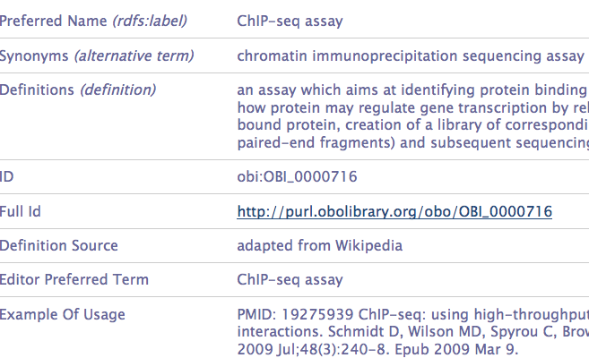
Search at BioPortal

Slide 9
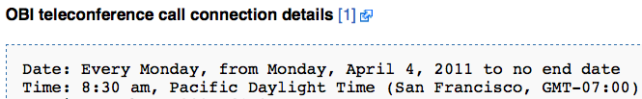
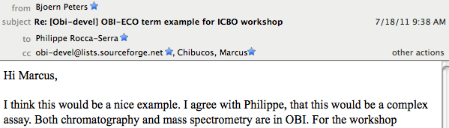
How to get involved with the OBI group
Participate in OBI developer calls
Attend an OBI meeting
Past OBI meeting in La Jolla, CA (March 2011)
Upcoming meeting place TBA, time TBA (Oct/Nov?)
Participate in the OBI developers mail list

Slide 10
Fortunate happenstance: OBI contacted ECO
Initial discussion with Philippe Rocca-Serra mid-2010
Could ECO be composed of OBI cross products?
ECO:xyz = inferred by + OBI:123
Cross reference ECO to OBI and eventually retire ECO?
Considerations for mapping ECO (or other ontology) to OBI
OBI more structurally complex than ECO
ECO easy for newcomers; would users switch to OBI?
Perhaps a “view” of large resources from OBI to meet particular goal?
Do all ECO terms “fit” into OBI?
author statement? assertion method and the internal cross products?
Feasible to make ECO-OBI completely interoperable
Or are they orthogonal?

Slide 11
How to prepare your ontology before working with OBI
Ontology cleanup
Knowing your users
What is your ontology trying to represent?

Slide 12
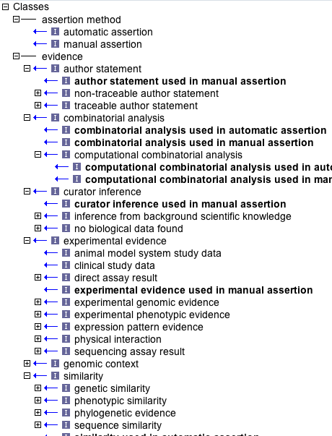
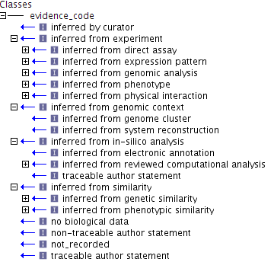
ECO development 2010-2011
New root class
Defined evidence
Grouping terms
Renamed evidence
Removed “inferred from”
Grouping terms
Merges
Rename terms
Synonyms
Spelling, Definitions, etc.
Obsolete

Slide 13
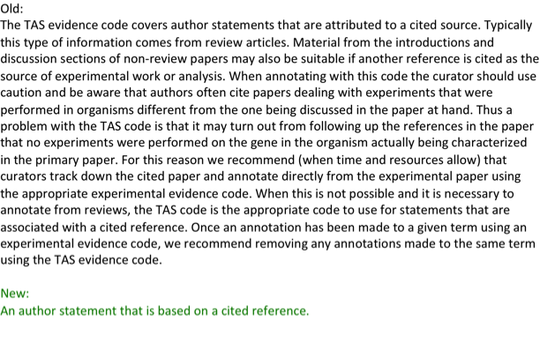
Definition rewriting
Define evidence: “A type of information that is used to support an assertion.”
Aristotelian definitions (B is an A that C’s)
Remove “used in” phraseology, usage notes & explicit reference to GO (add xrefs)
Allow interoperability with other ontologies

Slide 14
What does ECO represent?
ECO was mixed & had conflated several concepts:
Type of evidence (data/result vs. experiment/analysis/assay that generated it)
Evaluation/assessment of evidence
Assignment of evidence (i.e. in making an annotation)
Inference drawn from evidence
Confusion in term names, definitions, and inheritances:
fractionation data
direct assay result
genetic interaction experiment
reviewed computational analysis
transport assay
expression pattern evidence
inferred from genomic analysis
inferred from electronic annotation
not recorded
in-silico analysis
voucher specimen analysis is_a experiment

Slide 15
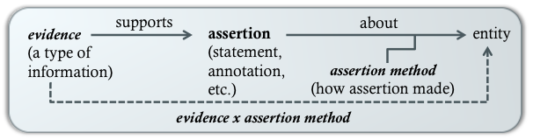
Initial analysis of ECO determined three main themes
ECO users seemed to want to represent (either in ECO or user annotation systems):
evidence – “a type of information that is used to support an assertion”
the assertion itself – stating a fact, asserting an inference, making an annotation…
assertion method – “a means by which a statement is made about an entity”

Slide 16
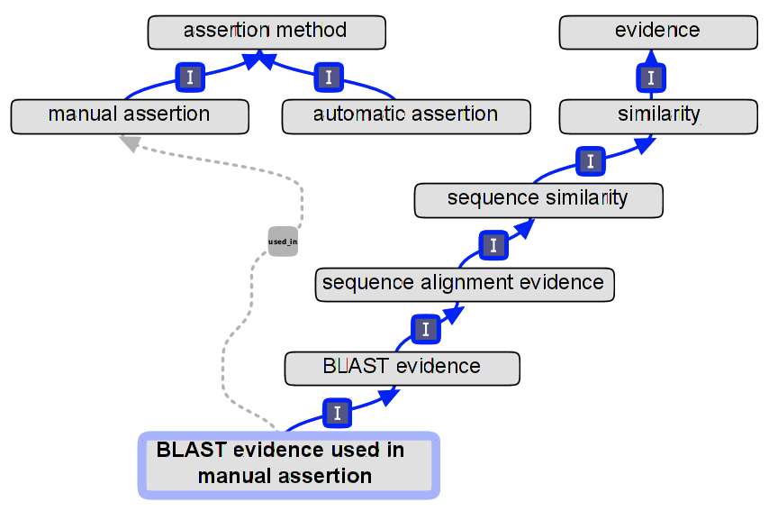
evidence and assertion method roots
Created new root class with two descendants
inferred from electronic annotation is now automatic assertion
Created new relationship used_in
(participant is between a process and an instance; but here we’ve got two instances.)
Now you can say evidence, as before, or evidence and how it was used… your choice!

Slide 17
Ongoing need to clarify evidence
Sorting evidence from assertion method a good start–we still must clarify what we mean by evidence:
Class of evidence?
Type of analysis performed?
The data that are output from an experiment?
The statement of fact that the data support?
phylogenetic evidence
combinatorial analysis, protein binding experiment, tissue ablation
motif similarity, structural similarity
flow cytometry data, chain termination sequencing result, sequence alignment evidence
ECO evidence remains a mix of processes their and outputs
Use OBI to guide term refinement & development

Slide 18
How can OBI guide development of your ontology?
Can the way information is represented in OBI help clarify thinking?

Slide 19
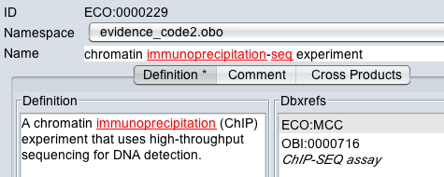
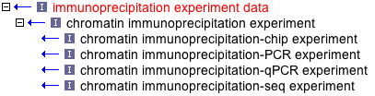
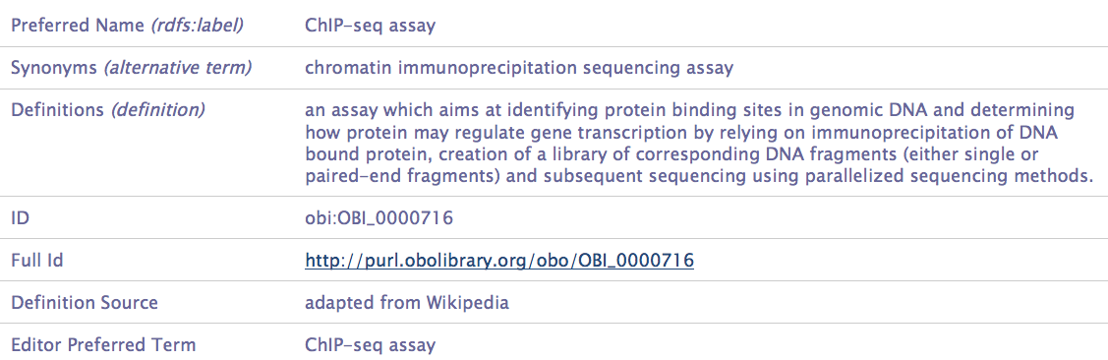
An example: how do ECO and OBI handle ChIP-seq assay?
ECO
OBI
…a couple of synonyms, too (not shown)

Slide 20
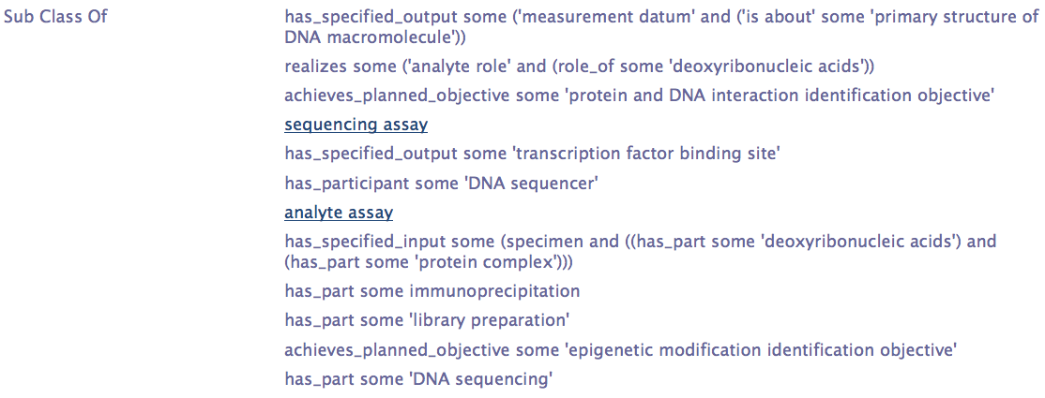
…now look at OBI subclasses!
ECO addressed these in the definition, but did not address many subclasses depicted here
OBI allows much more expressivity than ECO
Of critical importance as ECO users desire granularity
Best to call this term ChIP-seq assay in ECO and link it to an equivalent class in OBI that has a more expressive definition

Slide 21
Once again, what is evidence?
In OBI, “a data item is an information content entity that is intended to be a truthful statement about something… and is constructed/acquired by a method which reliably tends to produce (approximately) truthful statements”
Experimental data are specified outputs of processes
So, in ECO, perhaps we should opt to name things in terms of the process that generates the data?
combinatorial analysis, protein binding experiment, tissue ablation
flow cytometry, chain termination sequencing, sequence alignment
motif similarity, structural similarity
phylogenetic analysis

Slide 22
Surveying your ontology and comparing it to OBI

Slide 23
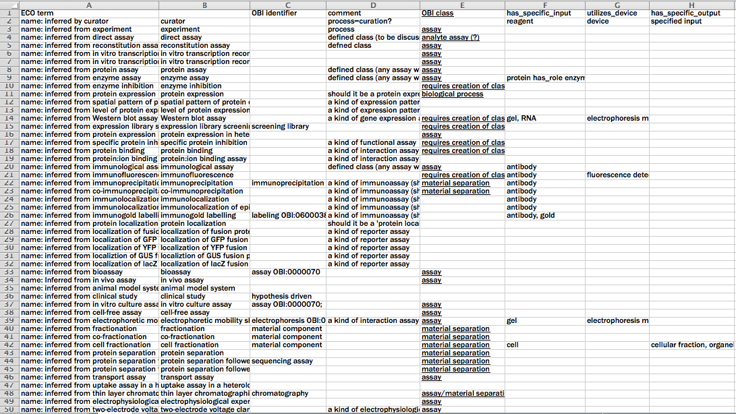
Mapping with a spreadsheet
(Thank you to Philippe Rocca-Serra for this information.)

Slide 24
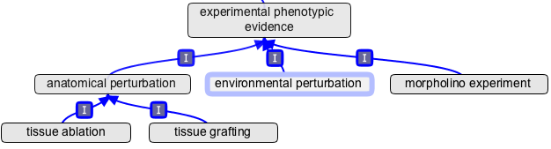
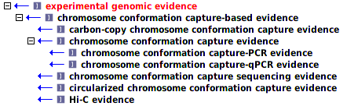
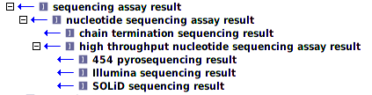
Can we map the many new ECO terms?

Slide 25
Examples of an initial mapping of an ontology to OBI

Slide 26
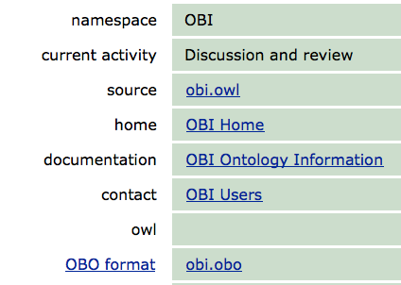
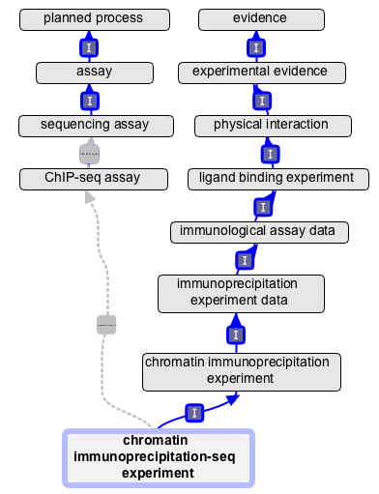
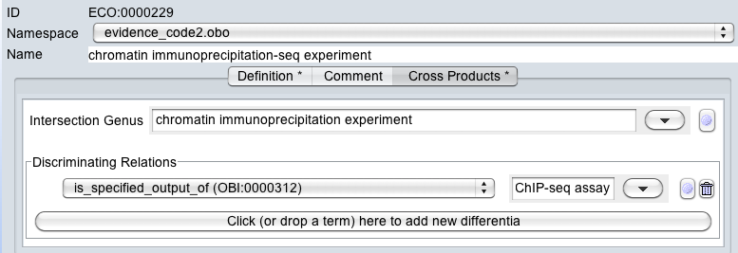
intersection_of: ECO:0000226 !
chromatin immunoprecipitation experiment
intersection_of: OBI:0000312 OBI:0000716 ! ChIP-seq assay
is_specified_output_of
rename to chromatin
immunoprecipitation-seq evidence

Slide 27
But how to map complex workflows?
A recent ECO term request:
“We are doing sub-cellular fractionation and subsequent protein identification using 2-D liquid chromatography MS/MS, Orbitrap electrospray ionization followed by high throughput analysis of the results to determine subcellular localization (GO CC).” (Thank you to Lakshmi Pillai & Fiona McCarthy for this request.)
Very difficult under ECO framework
How might OBI handle this?

Slide 28
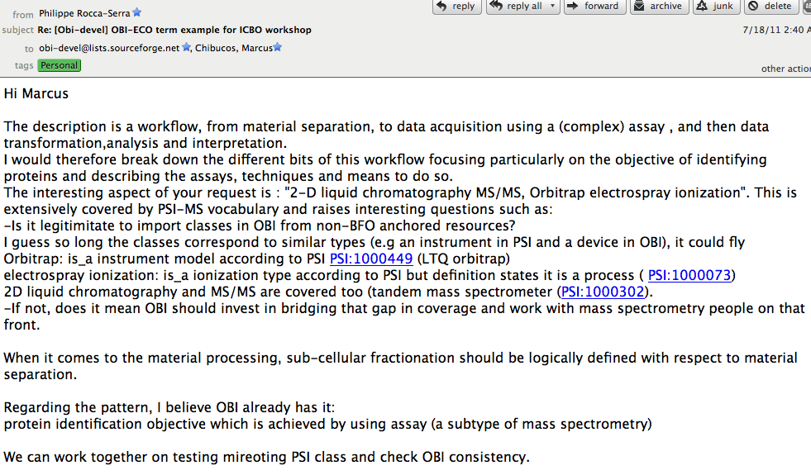
OBI developers jump into action!
This led to a very interesting discussion on OBI devel…

Slide 29
Advice to anyone trying to map an ontology to OBI
Reciprocal analysis of ECO/OBI
Look for assays present in ECO but missing in OBI
Submit those via term tracker
Should OBI import ECO terms?
Careful analysis to avoid multiple inheritance problems
Absence of definition creates difficulty, too
Collect use cases of how ECO is being used
What are costs/benefits of switch from ECO to OBI terms?
Must avoid disruption of curation practice by ECO users
ECO developers join OBI devel list and OBI calls
Contribute and critically review OBI
Point to areas OBI can better serve ECO needs
Generate cross products ECO/OBI
Do some term creation…
Clean up your own ontology…
Know your users…
Become active in OBI…
Make the switch…

